Slide 1



X
Machine Learning Project: Regression and Clustering Models for Product Sales Analysis
Project Based Internship KALBE Nutritionals - Data Scientist
Presented by
Okky

Slide 2


Machine Learning
Project
Okky Darmawan Kostidjan
Exploratory Data Analysis (EDA)
Machine Learning Regression (Time Series)
About You
“I am a qualified analyst with 5 years of experience in the field of analysis, specifically as an Inventory Analyst. My are of expertise are in maintaining stock availability, analyzing causes of product damage, and generating sales and analytical reports. ”
Machine Learning Clustering (KMeans)

Slide 3
Exploratory Data Analysis (EDA)
Exploratory Data Analysis (EDA) using DBeaver and Tableau Public

Slide 4
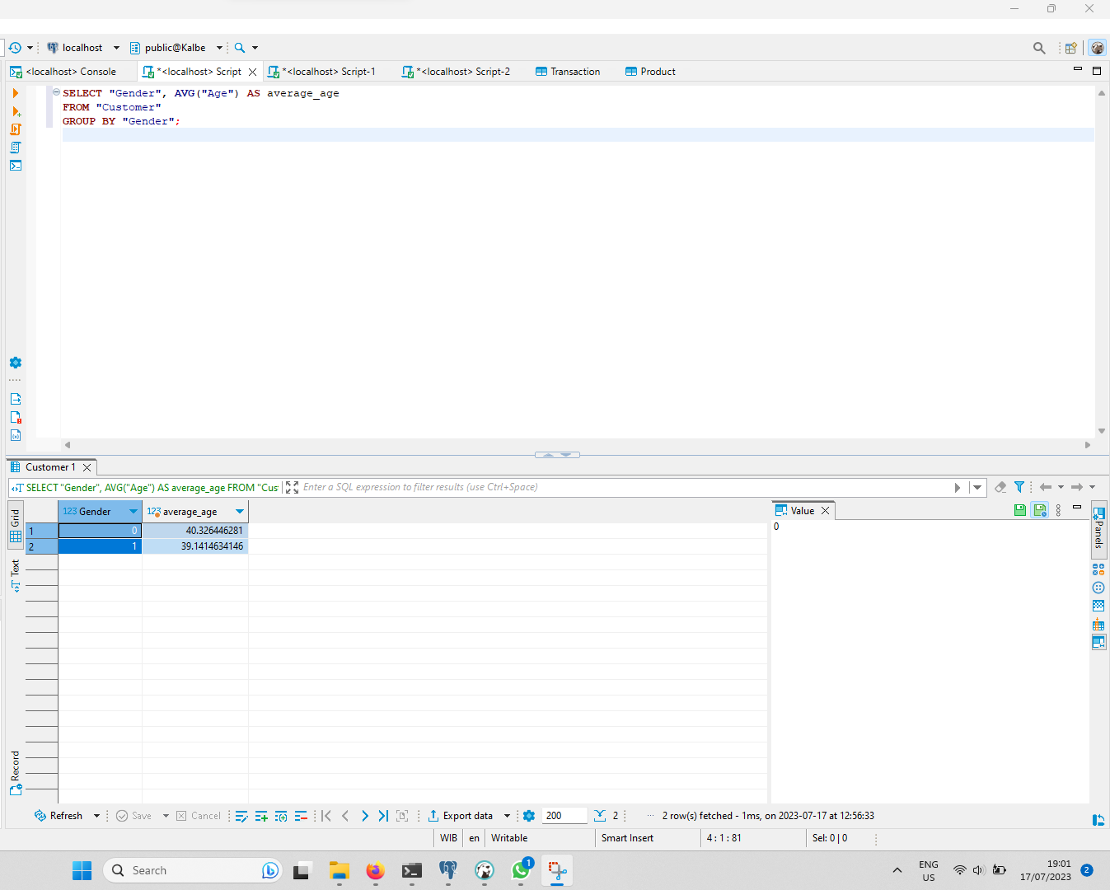
Average Customer Age by Gender

Slide 5
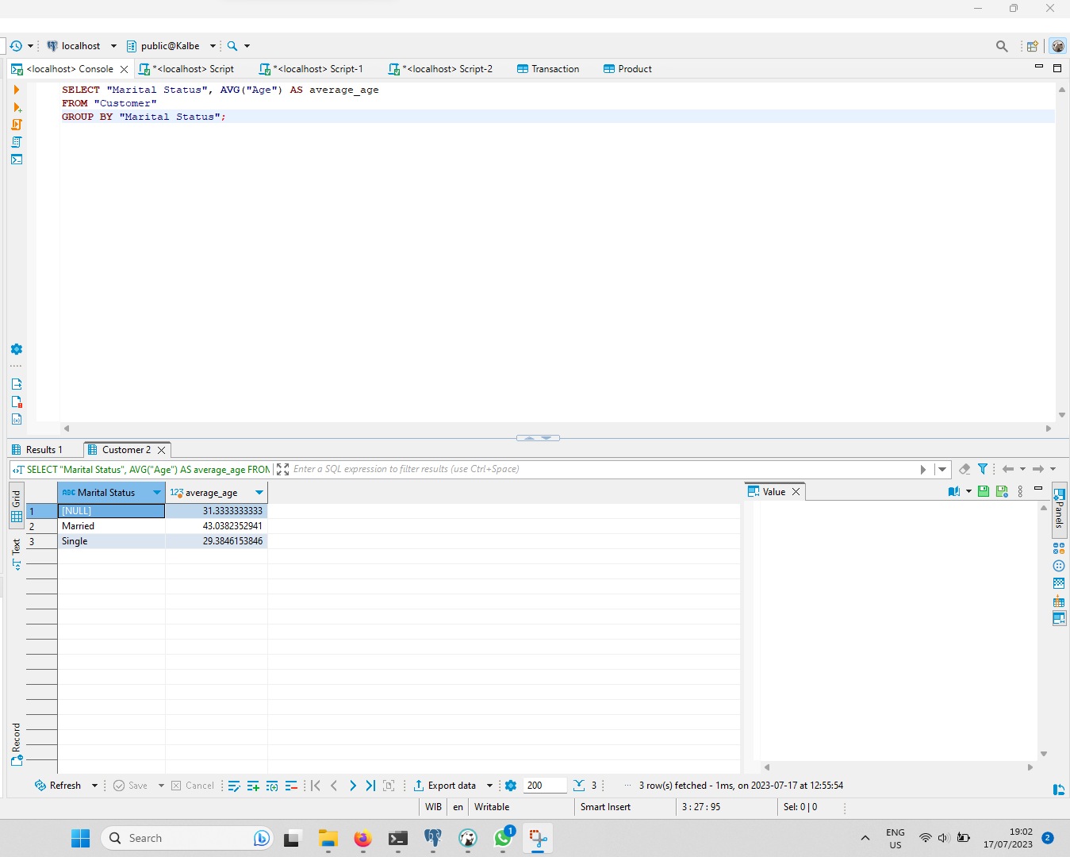
Average Customer Age by Marital Status

Slide 6
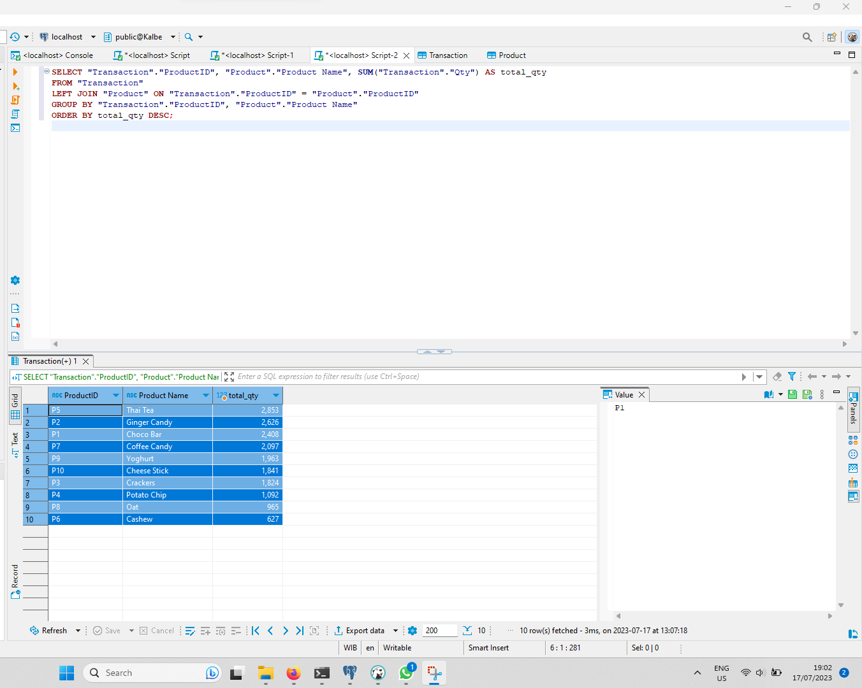
Top Product By Sales Qty

Slide 7
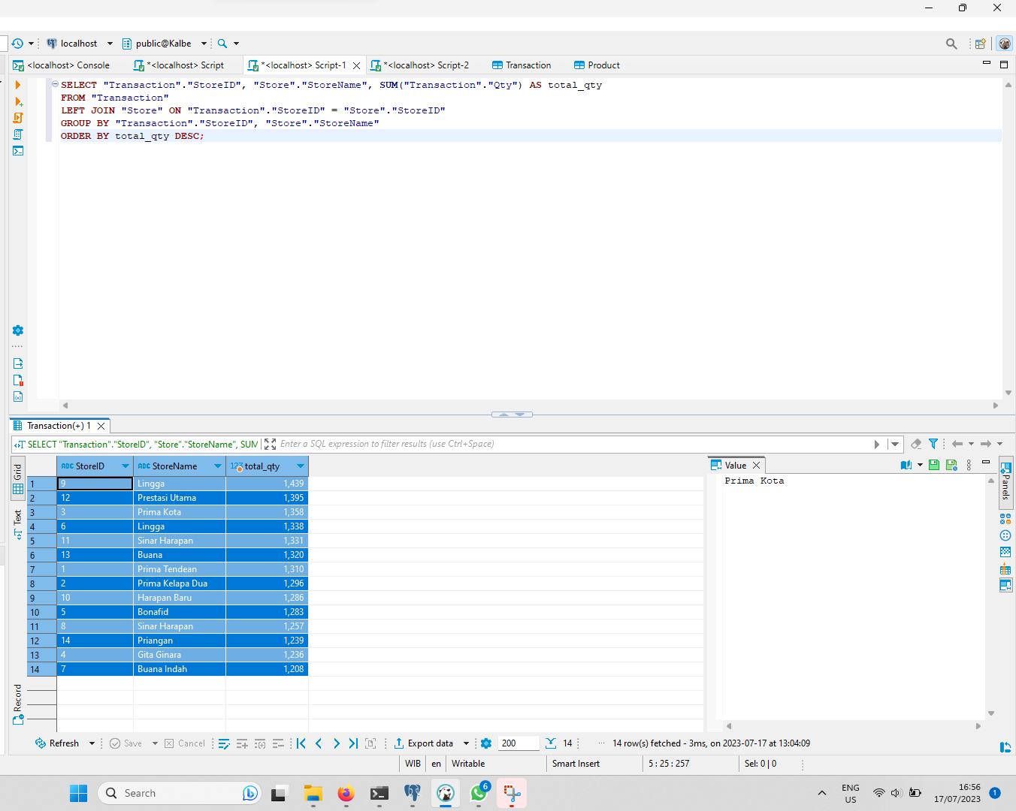
Top Store By Sales Qty

Slide 8
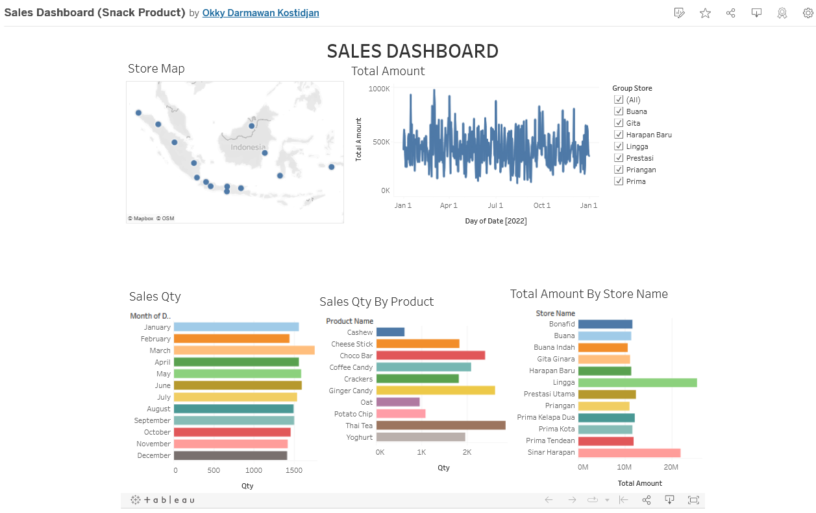
Sales Dashboard
Link Dashboard here . . .

Slide 9
Machine Learning Regression (Time Series)
Create a machine learning model to predict the daily quantity of product sales using ARIMA Method

Slide 10
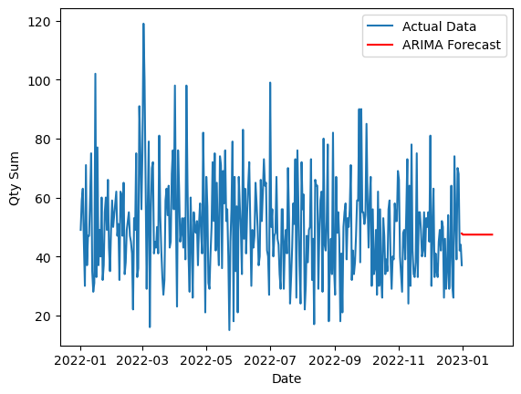
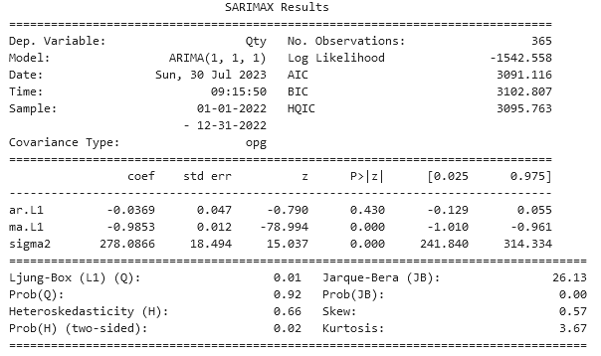
Overall Product Sales Forecast
Link Dashboard here . . .

Slide 11
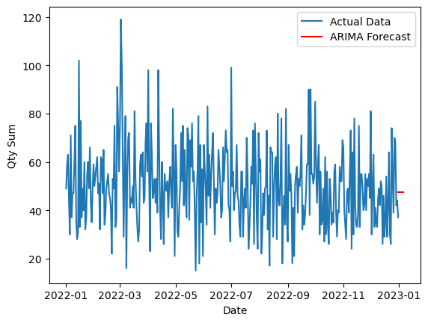
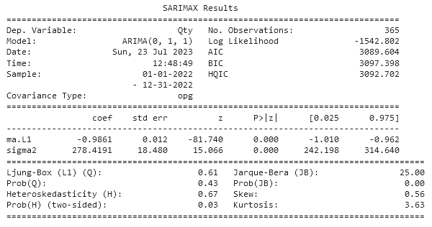
Tuning Hyper Parameters
Link Dashboard here . . .

Slide 12
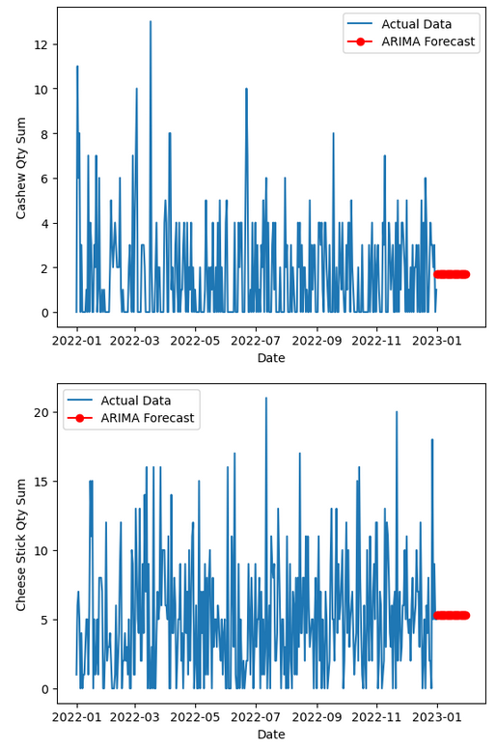
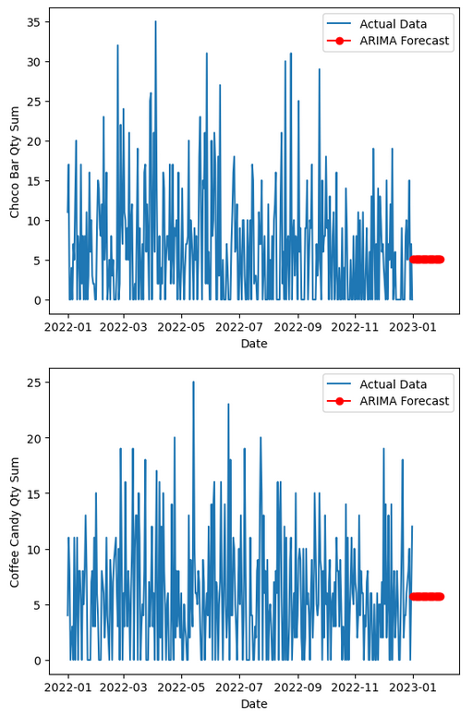
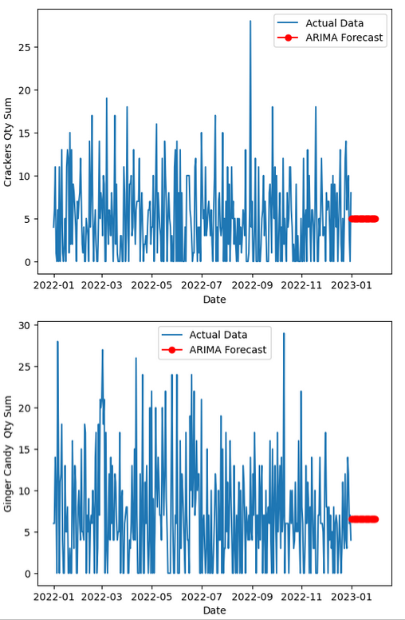
Product Sales Forecast

Slide 13
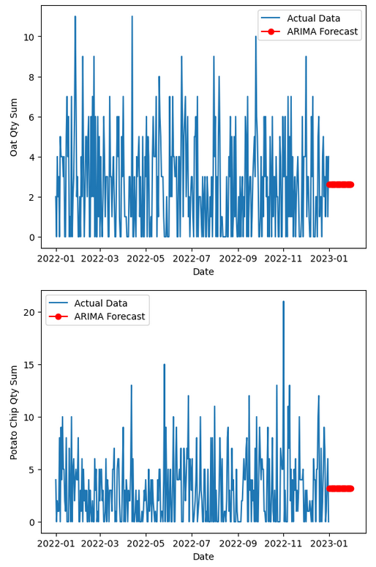
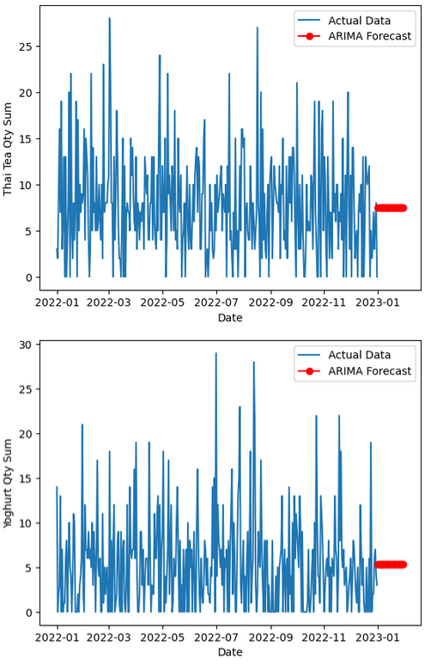
Product Sales Forecast

Slide 14
Machine Learning Clustering (KMeans)
Create a machine learning model to grouping customers with similars behaviours.

Slide 15
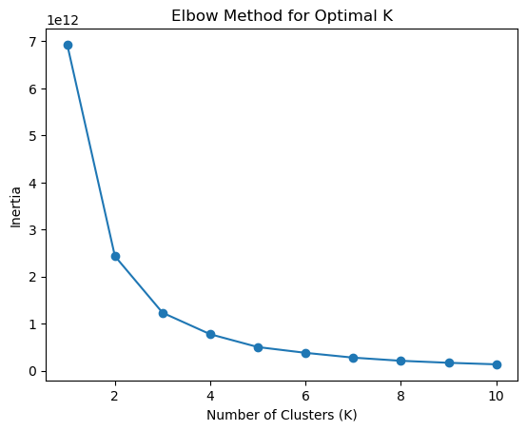
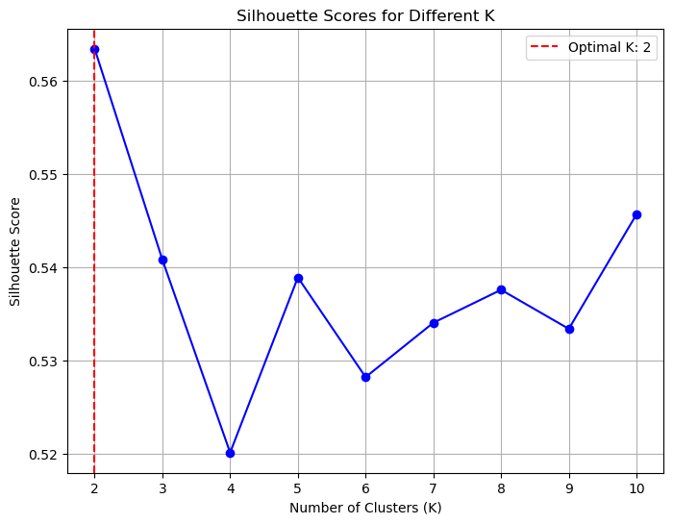
Clustering

Slide 16
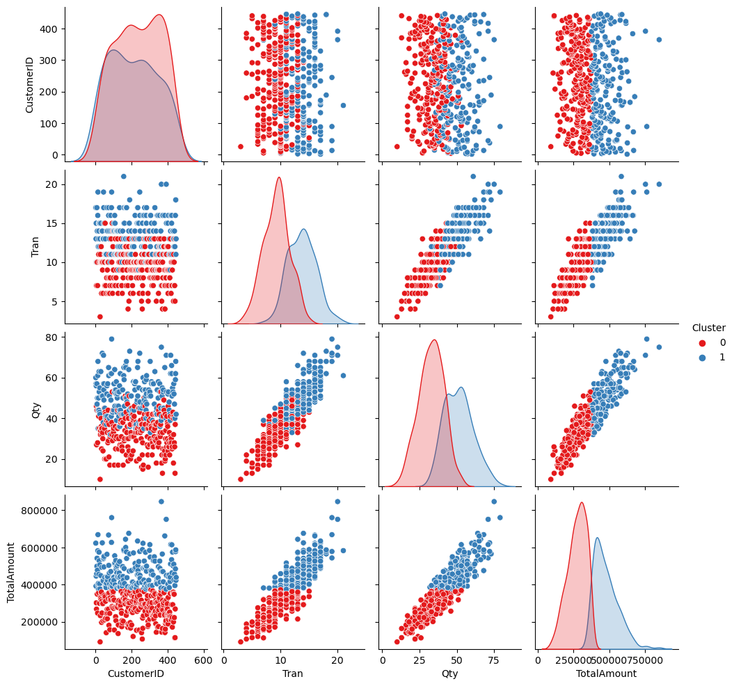
Result
From the clustering process using the k-means method and the pairplot, it can be concluded that the optimal number of clusters is 2 clusters, with the first cluster characterized by customers with lower quantities, transactions, and total transaction amounts compared to the second cluster.

Slide 17
Thank You
X

Slide 18
Github : OkkyDK

Slide 19
Video Presentation Here
Please insert your link video here (You can upload the video on YouTube or Google Drive first)!

